Slide 1
Office 365 Development

Slide 2
O3656-2 Deep dive into SharePoint lists for data storage
Speaker
Speaker

Slide 3

Agenda
Motivation
Site Columns and Content Types
Creating Custom Lists using XML
Updating Site Columns and Content Types
Creating Custom Lists using CSOM

Slide 4
Motivation

Slide 5















Vision
EXTEND OFFICE EVERYWHERE
CONNECT TO OFFICE 365 SERVICES
BUILD USING AN OPEN PLATFORM
Delve
z
Users and groups
Files
Mail
Calendar
My Apps
Video Portal
Contacts
Office Graph
Presentations
Documents
Spreadsheets
Lync
OneNote
Yammer

Slide 6
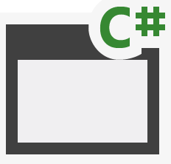
SharePoint App Building Blocks
SharePoint Apps
aspx
Databases
png
master
CSS
js
Web Services
SharePoint
REST
CSOM
SharePoint API
Managed
Metadata
Search
Service
Workflow
Service
BCS
List and Libraries
Service Applications

Slide 7
Why Use SharePoint Lists and Libraries?
Reduce/eliminate dependencies on external storage
Leverage SharePoint's familiar UX to view, modify and search through list items and documents
Leverage SharePoint's document management capabilities
Leverage SharePoint's content versioning capabilities
Leverage site columns to make content more searchable

Slide 8
Site Columns and Content Types

Slide 9
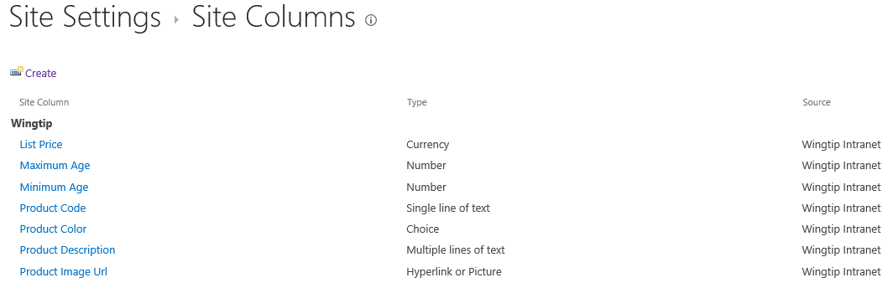
Site Columns
Reusable column templates that define…
The underlying field type for column value
The default value
Rendering characteristics
Each site has its own Site Column Gallery
Site columns available in current site and sites below
Site columns in top site available to site collection
Notes:
A site column represents the definition for a reusable column templates. Each site column defines an underlying field type for column value, a default value and the rendering characteristics for that field type. For example, a site column based on the underlying field type of Currency can define the formatting in terms of US Dollars.
Each site has its own Site Column Gallery. This is true of both top level sites as well as child sites. A site column in the site column gallery is available for use in the current site and in child sites below in the site hierarchy. A site column in the site column gallery of the top-level site is available for use throughout the entire site collection.

Slide 10
Content Types
Reusable item/document templates that define…
A parent content type
A collection of site columns
Each site has its own Content Type Gallery
Content types available in current site and sites below
Content types in top site available to site collection
Notes:
A content type is a reusable template of site columns used for an item or document. Since we are concentrating on publishing sites in this course, we are interested in content types that are used behind the Pages document library.
Each content type lives in a large hierarchy of content types and therefore must be defined with a parent content type. The content type inherits a set of site columns from its parent content type and can add more of its own.
Just like site columns, content types are tracked in a content type gallery. Each site within a site collection has its own Content Type Gallery. Content types in a content type gallery are available in the current site as well as in child sites below in the sire hierarchy. Content types that have been added to the content type gallery of the top-level site are available for use throughout the current site collection.

Slide 11
Content Type Hierarchy
Content types designed in hierarchy
All content types inherit (aka derive) from Item
Child content type inherits site columns from parent
Child content type can add new site columns
Child content type can remove site columns inherited from parent
SharePoint content type hierarchy
Item
Announcement
Contact
Task
Document
Form
Picture

Slide 12
Creating Custom Content Types
Creating a custom content type
Select a content type name
Select a parent content type to inherit from
Add whatever site columns are required
Configure content type settings
SharePoint-supplied content types
Item
Document
Custom content types
Book
Book Cover Image

Slide 13
Creating Custom Lists using XML

Slide 14
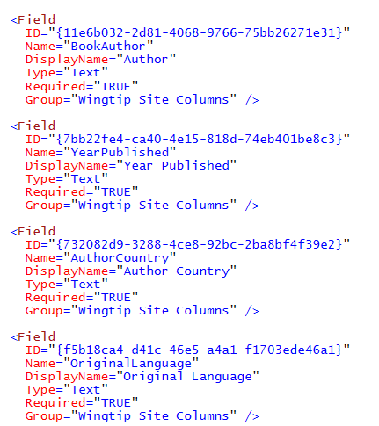
Creating Site Columns using XML
Site columns can be created declaratively
Declarative XML element activated using feature

Slide 15
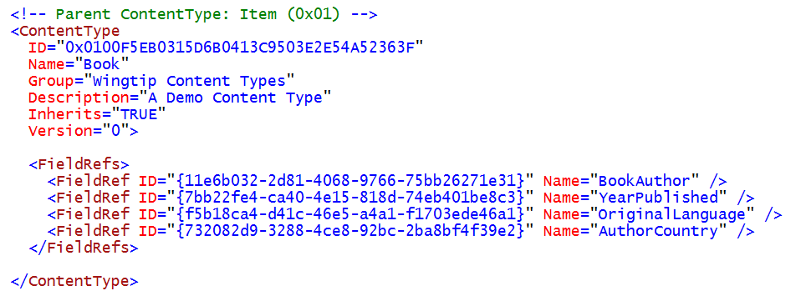
Creating Content Types using XML
This example shows a custom content type
Designed for use custom Books list type

Slide 16
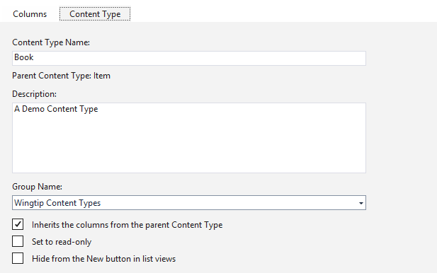
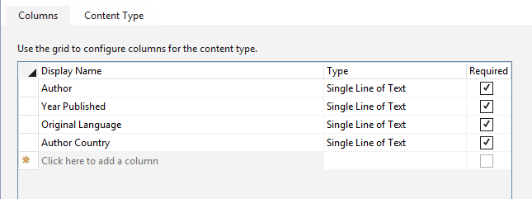
Visual Studio Content Type Designer
Makes it easier to work with content types
You don't need to work directly with XML elements
Site columns added to content type from dropdown list

Slide 17
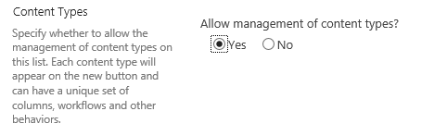
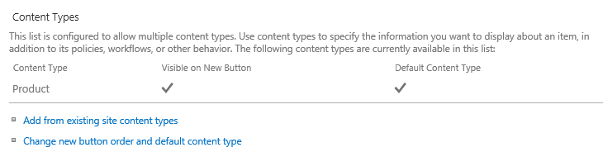
Lists and Content Types
List contains a collection of content types
Every list must contain at least one content type
Content types hidden on the List Settings page by default
Advanced Settings page for list provides option to show them
Content Types section allows for adding/removing content types

Slide 18
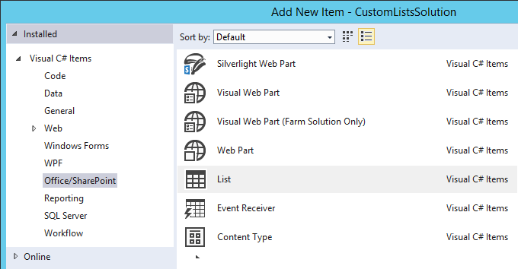
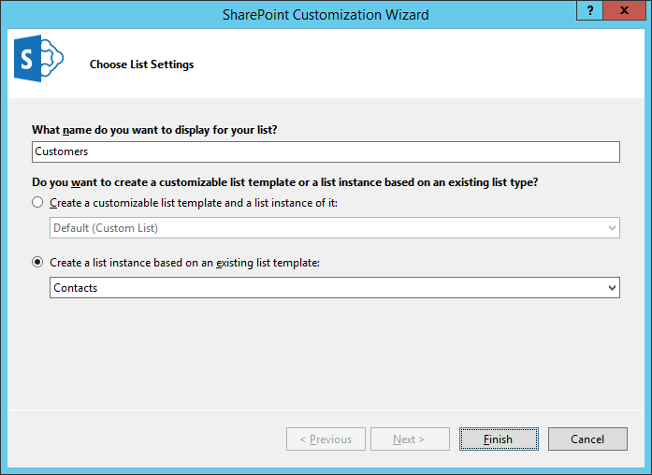
Creating Lists with Visual Studio
Visual Studio provides support for creating SharePoint lists
SharePoint list added to Visual Studio projects using List item template
SharePoint lists supported in SharePoint solutions and SharePoint apps
Options when creating list
list instance based on existing list type
customizable list template with instance
create customizable list template
create standard list

Slide 19
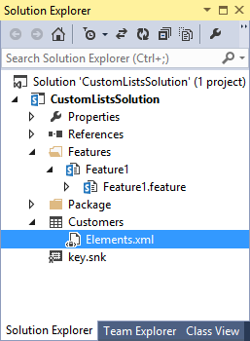
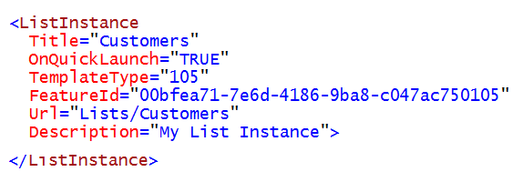
Creating a Standard List Instance
Creating using ListInstance element
Title: acts as list display name
URL: URL offset from root of site
TemplateType: ID of standard SharePoint list type
FeatureId: ID of SharePoint feature which provide list type

Slide 20
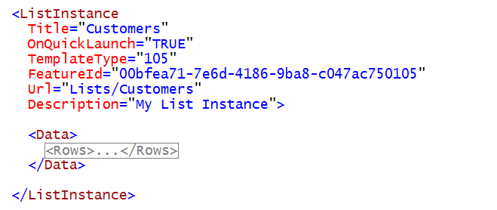
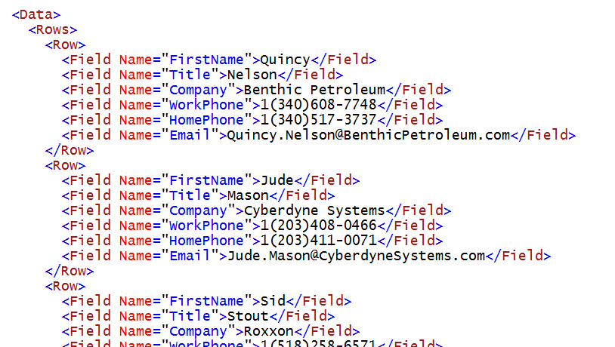
Populating a New List with Items
List can be created with pre-populated items
Item data added in Rows and Row elements
Item column values assigned using site column names

Slide 21
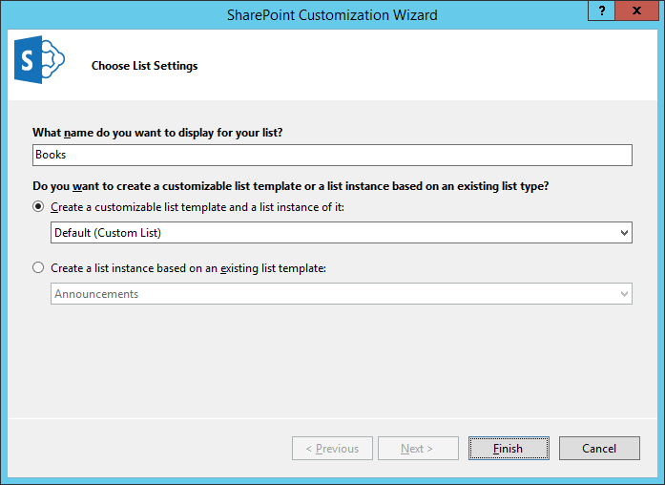
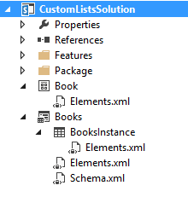
Creating Customizable List Templates
Select standard List type when creating template
Affects initial set of list columns and list content type
Schema.xml contains SharePoint list definition
First Elements.xml file added with ListTemplate element
Second Elements.xml file added with ListInstance element
List Instance Element
List Template Element
List Template Definition

Slide 22
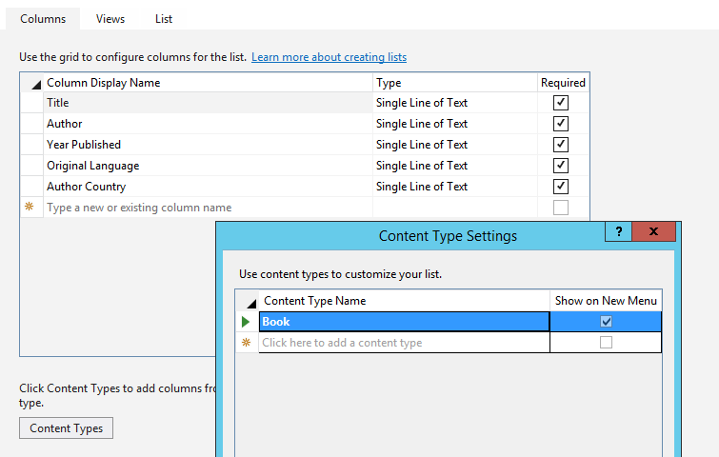
Visual Studio List Designer
List Designer abstracts away XML in Schema.xml
Used to add columns and content type support
Used configure list properties and add/modify views

Slide 23
demo
Creating site columns, content types and lists using XML

Slide 24
Updating Site Columns and Content Types

Slide 25
Feature Upgrade
Used to version feature instances in production
Supported in SharePoint 2010 and SharePoint 2013
How does it work?
Feature definition is modified with Upgrade Actions
New feature definition pushed out using solution update
Feature instances queried and explicitly upgraded
Notes:
Previously SharePoint did not have a way to upgrade deployed Features. Developers were left to write custom code to handle these scenarios on their own.
SharePoint 2010 introduced the ability to write custom upgrade actions. There is a declarative option but when that doesn’t satisfy the requirements, developers are given a way to wire up custom code.

Slide 26
UpgradeActions
Instructions for what to do during feature upgrade
ApplyElementManifest – used to process element manifest
CustomUpgradeAction – used to execute event handler
MapFile – used to remap existing file URL to new physical file
AddContentTypeField – used to add new column to existing content type
<Feature xmlns="http://schemas.microsoft.com/sharepoint/"
Id="86689158-7048-4421-AD21-E0DEF0D67C81"
Title="Wingtip Lead Tracker"
Version="2.0.0.0" Scope="Web">
<ElementManifests>
<ElementManifest Location="elements.xml" />
<ElementManifest Location="elements_v2.xml" />
</ElementManifests>
<UpgradeActions>
<VersionRange BeginVersion="1.0.0.0" EndVersion="2.0.0.0">
<ApplyElementManifests>
<ElementManifest Location="elements_v2.xml"/>
</ApplyElementManifests>
</VersionRange>
</UpgradeActions>
</Feature>
<Elements xmlns="http://schemas.microsoft.com/sharepoint/">
<ListInstance Id="SalesLeads"
TemplateType="105"
Title="Sales Leads"
Url="SalesLeads"
OnQuickLaunch="TRUE" />
</Elements>
Notes:
With SharePoint 2007 you already had some upgrade scenarios but they were far from complete.
SharePoint 2010 addressed this problem by adding upgrade actions to the schema. These actions allow for declarative upgrades and code-based upgrades. Define declarative upgrades using elements like <ApplyElementManifests>, <AddContentTypeField>, <MapFile>, <CustomUpgradeAction>. Code-based upgrades are defined using the <CustomUpgradeAction> element.
There is also a FeatureUpgrading event added to the FeatureReceiver class. This event is triggered when a feature is upgraded.

Slide 27
Upgrading Content Types
Use Upgrade Action named <AddContentTypeField>
Enables developers to easily upgrade content types
<?xml version="1.0" encoding="utf-8" ?>
<Feature xmlns="http://schemas.microsoft.com/sharepoint/">
<UpgradeActions>
<VersionRange BeginVersion="1.0.0.0" EndVersion="2.0.0.0">
<AddContentTypeField
ContentTypeId="0x010600ADFF3A525118400BA1271AAAAB3A7F4B"
FieldId="{41f2138d-f9d7-4bd8-a369-54054b016c22}"
PushDown="TRUE"/>
</VersionRange>
</UpgradeActions>
</Feature>
Notes:
In SharePoint 2007 it is not easy to upgrade the definition of existing content types.
SharePoint 2010 added new elements to the CAML schema that allows for a better upgrade scenario. You can use the <UpgradeActions> element within the <Feature> element to indicate that you want to upgrade a feature. Within the <UpgradeActions> element you can place elements like <AddContentTypeField> to add a new field to a provisioned content type and to propagate the change to child lists and content types.

Slide 28
Triggering Feature Upgrade
Updating solution do not trigger feature upgrade
Feature instances must be queried and upgraded
Typically done using a Windows PowerShell script
Add-PSSnapin Microsoft.SharePoint.Powershell -ErrorAction SilentlyContinue
$WebAppUrl = "http://intranet.wingtip.com"
$featureId = New-Object System.Guid -ArgumentList "86689158-7048-4421-AD21-E0DEF0D67C81"
$webApp = [Microsoft.SharePoint.Administration.SPWebApplication]::Lookup($WebAppUrl)
$features = $webApp.QueryFeatures($FeatureId, $true)
foreach($feature in $features){
Write-Host "Updating feature in "$feature.Parent.Url
$feature.Upgrade($true)
}
Notes:
The process of upgrading a Feature is not an automation action. This is something a developer or administrator must perform at the console of the server.
The snippet in the screenshot in this slide demonstrates a process of getting a list where a specific Feature has been activated. It then walks through all these instances it found and upgrades each one.

Slide 29
Upgrading Content Types – Special Note
Upgrading content types should be thoroughly tested in each scenario
Strongly recommended to read the following resources:
Patterns & Practices: SharePoint Guidance http://msdn.microsoft.com/en-us/library/ff770300.aspx
P&P: SharePoint Guidance: Columns, Lists & Content Types http://msdn.microsoft.com/en-us/library/ff798404.aspx
MSDN Documentation: Updating Content Types http://msdn.microsoft.com/en-us/library/aa543504.aspx
Notes:
The process of upgrading existing content types has been a dynamic challenge since they were introduced in SharePoint 2007. While the improvements in upgrade actions added in SharePoint 2013 are quite helpful and updating content types through the browser is straightforward and reliable, it is strongly recommended that developers review the documentation links in this slide. There are so many different scenarios and conditions that could happen that it is best for developers to get a solid understand of what options are available, what are the advantages and disadvantages of each and come up with their own process.

Slide 30
Creating Custom Lists using CSOM

Slide 31
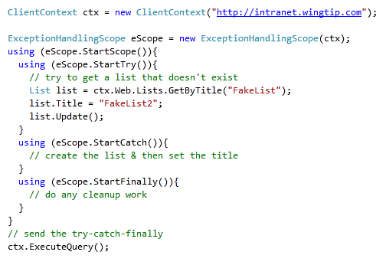
Remote Error Handling
CSOM supports structured exception handling
However, it’s an API not a language feature
Reduces chatty & time consuming round-trips to server
Notes:
After creating the ClientContext, you can create a ExceptionHandlingScope. You can wrap up all your code that communicates with the client object model within a using(eScope.StartScope()){...} to avoid that exceptions go back and forth over the wire. All exceptions are queued and can be checked in the using (StartCatch()){...} part of your code.

Slide 32
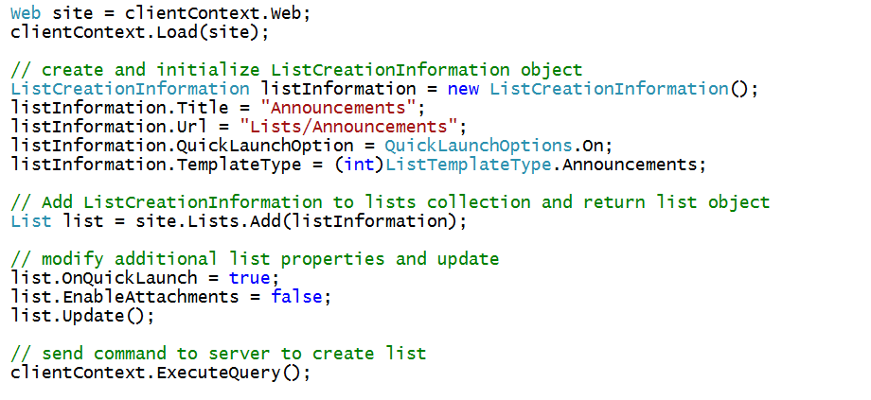
Creating a List

Slide 33
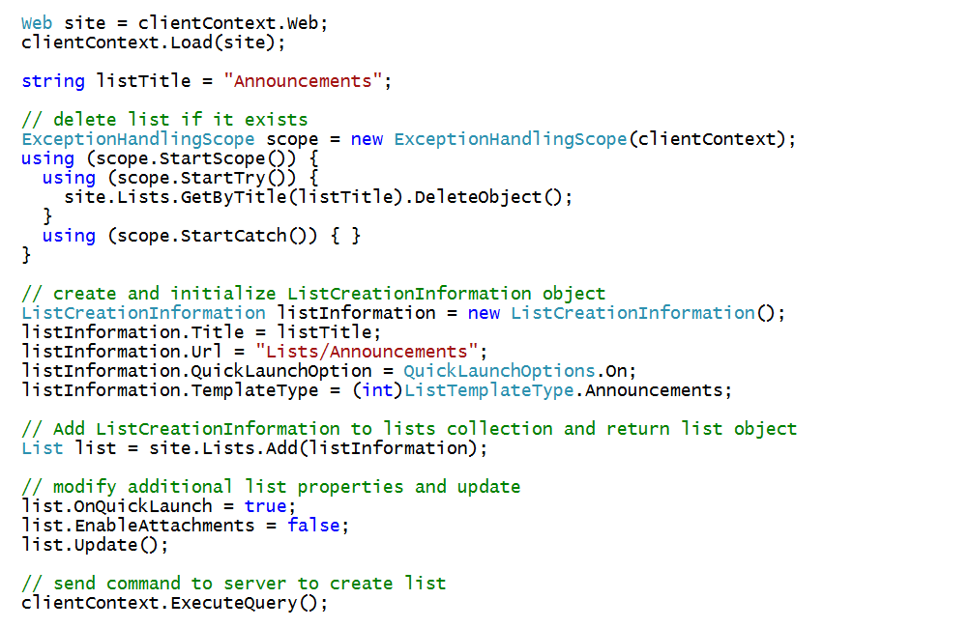
Checking Whether the List Already Exists

Slide 34
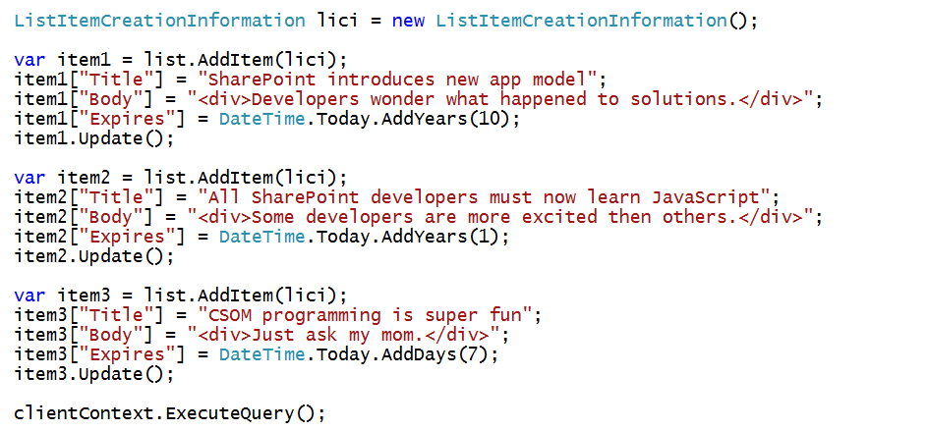
Creating List Items

Slide 35
demo
Creating site columns, content types and lists using CSOM

Slide 36
Summary
Motivation
Site Columns and Content Types
Creating Custom Lists using XML
Updating Site Columns and Content Types
Creating Custom Lists using CSOM

Slide 37
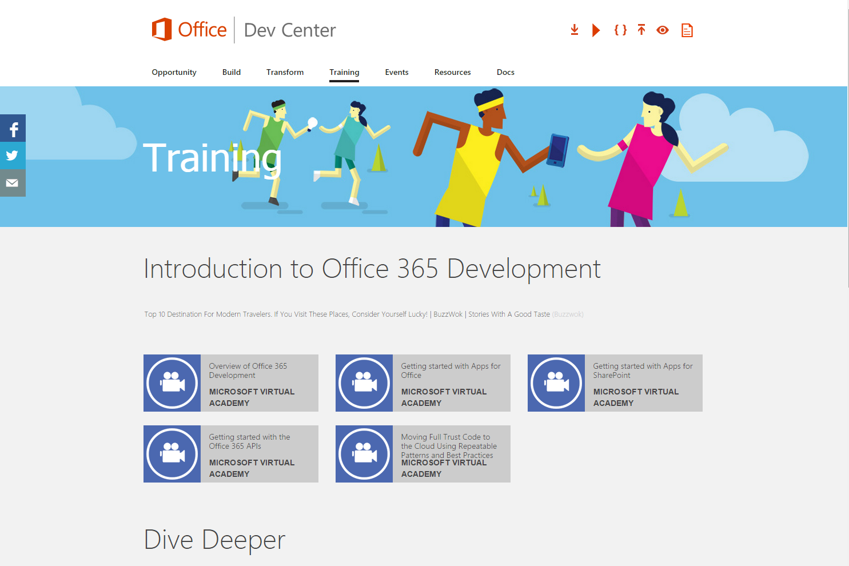
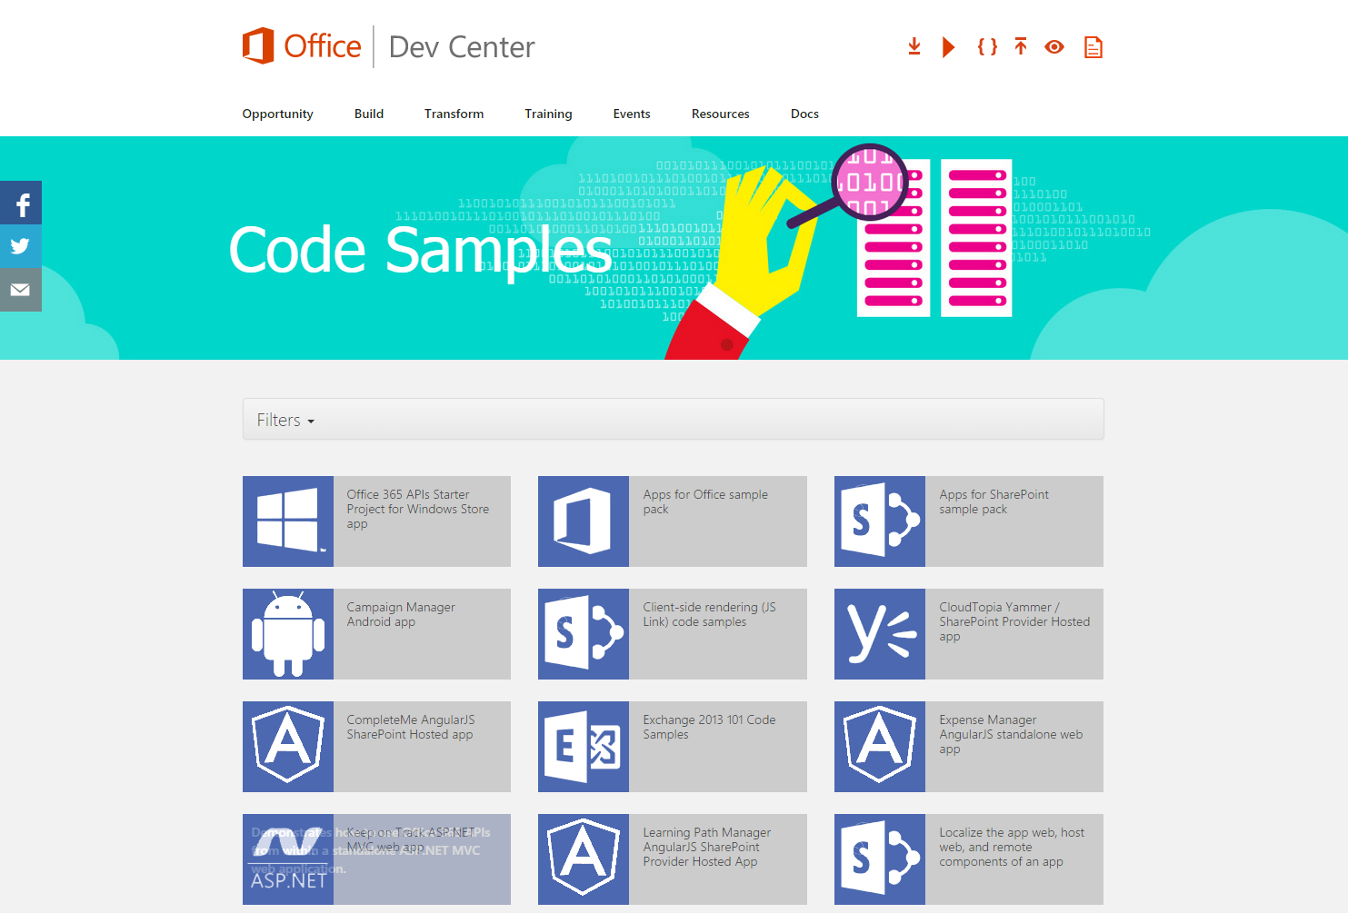
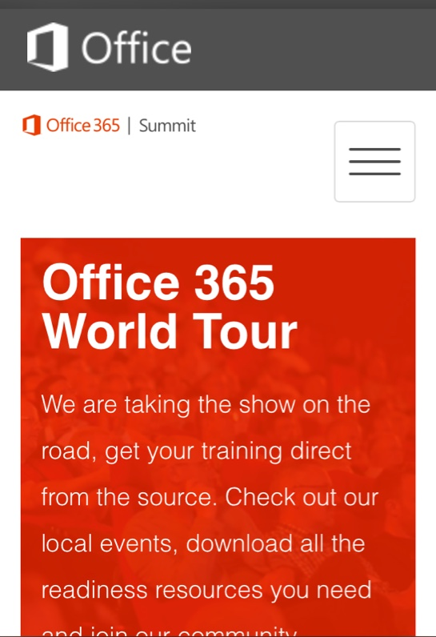
dev.office.com
Sign up
http://dev.office.com/getting-started
Explore
http://apisandbox.msdn.microsoft.com
Get trained http://dev.office.com/training

Slide 38


Feedback
Office 365 Network Share you best practices and join conversations https://www.yammer.com/itpronetwork
Stackoverflow Ask deep technical questions to a world-wide set of developers
http://stackoverflow.com/questions/tagged/ms-office
UserVoice Provide suggestions of what you want in future versions
http://officespdev.uservoice.com/

